Slide 1
Presented By Siphiwosabo Ndlovu
Car Sales Performance & Strategic Analysis

Slide 2



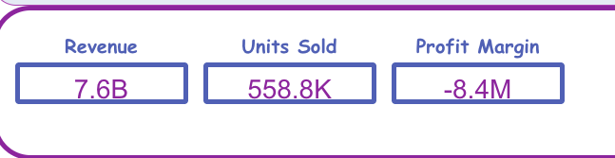
Project Objectives
-Identify top revenue-generating makes and models.
Analyze the relationship between pricing, mileage, and vehicle age.
Evaluate regional performance and emerging customer preferences

Slide 3
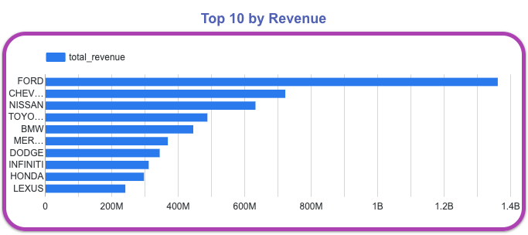
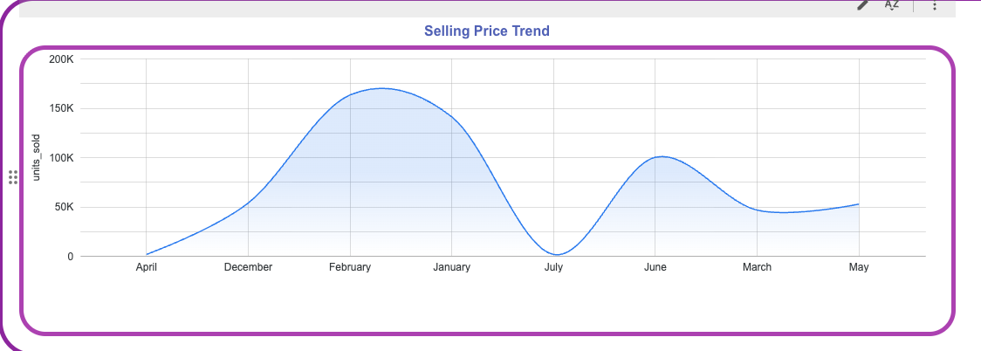
Revenue Drivers by Make
Key Insight: Specific brands represent a disproportionate share of total revenue.
Strategy: Prioritize inventory procurement for these high-performing makes to ensure consistent cash flow.

Slide 4
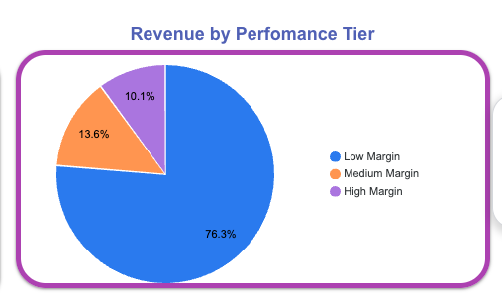
Profitability & Inventory Tiers
High Margin Tier (>10%): These vehicles are our most efficient assets and should be the focus of inventory expansion.
Low Margin Tier (<5%): Requires optimized pricing or promotional strategies to increase turnover and clear storage space.

Slide 5
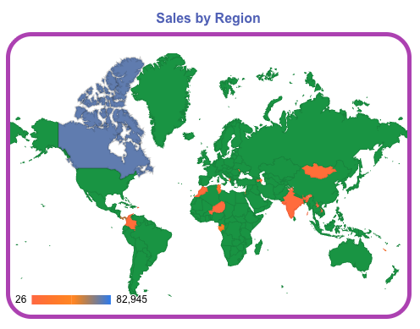
Regional Sales Performance
Top Performer: California (CA) leads in total units sold.
Recommendation: Focus dealership network expansion in high-volume hubs to capture existing market demand.

Slide 6
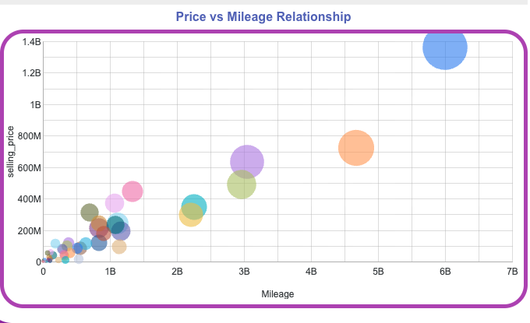
Price vs. Mileage Relationship
Trend: There is a clear correlation between lower mileage and higher profit margins.
Procurement Action: Target vehicles with lower mileage within the top-performing makes to maintain high-margin stock.

Slide 7

Strategic Recommendations
Inventory Optimization: Shift procurement focus toward high-margin performance tiers.
Regional Strategy: Expand footprint in high-volume regions like CA.
Continuous Monitoring: Utilize the interactive Looker Studio dashboard for real-time tracking of sales trends and pricing.

